Slide 1
Bagging
in Ensemble Learning

Slide 2
Bagging in Ensemble Learning
Bagging (short for Bootstrap Aggregating) is an ensemble learning technique that builds multiple versions of the same model on different random subsets of the training data and then combines their predictions (by averaging for regression or voting for classification) to improve accuracy and reduce overfitting.
Core Idea
Instead of training one model on all the data, we:
Randomly create bootstrap samples (sampling with replacement from the dataset).
Train a separate model on each sample.
Combine predictions from all models for the final output.

Slide 3
How Bagging Works (Step-by-Step)
Age | Gender | Score | class
20 | M | 100 | Pass
30 | F | 300 | Pass
25 | M | 30 | Fail
Bootstrap Sampling
From a dataset of N examples, take N samples with replacement to form a new dataset.
Repeat this process k times to make k datasets.
Model Training
Train the same base model (e.g., Decision Tree) on each dataset independently.
Prediction Aggregation
For classification → Take majority vote of all models.
For regression → Take average of all predictions.
Age | Gender | Score | class
20 | M | 100 | Pass
30 | F | 300 | Pass
25 | M | 30 | Fail
Age | Gender | Score | class
20 | M | 100 | Pass
30 | F | 300 | Pass
25 | M | 30 | Fail
Age | Gender | Score | class
20 | M | 100 | Pass
30 | F | 300 | Pass
25 | M | 30 | Fail
M1
M2
M3
Combine Prediction

Slide 4
Example
Imagine predicting whether customers will buy a product:
Instead of 1 Decision Tree, you train 10 Decision Trees, each on different random samples of your data.
Then:
If most trees say “Yes”, the final answer is “Yes”.
If it’s regression (e.g., predicting spending amount), you average the values.
Real-World Example
Random Forest is one of the most famous bagging-based algorithms — it’s basically Bagging + Decision Trees + Random Feature Selection.

Slide 5
Applications
Domain | Use Case
🛒 E-commerce | Customer segmentation, recommendation engines
💳 Finance | Credit scoring, fraud detection
🏥 Healthcare | Disease prediction, patient risk assessment
📈 Marketing | Predicting customer churn
📊 Data Science | Kaggle competitions (widely used model)
🔍 Search Engines | Ranking search results

Slide 6
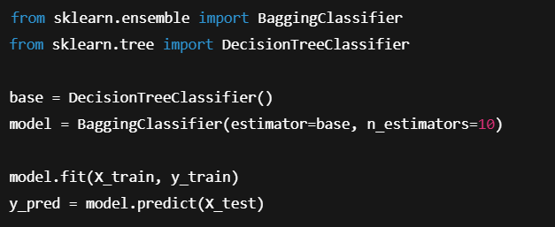
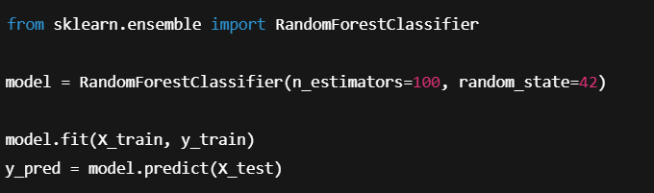
Code Implementation
Parameter | Description
n_estimators | Number of trees to build

